Slide 1
Alabama Quality STARS Updates
Presented by the Alabama Department of Human Resources-Child Care Services Division

Slide 2
Topics covered today
QRIS Eligibility
Changes in STAR Ratings
Incentive Model

Slide 3
QRIS Updates
Changes are retroactive to July 1, 2026
Changes are specifically to incentive payments and processes
All QRIS participating providers not currently in the Arise CARE system now must register in the system and maintain enrollments
Payments are based on enrollments instead of capacity
Providers are subject to file audits of enrolled children

Slide 4
Why Changes to the Current System
Over inflated capacities
Providers with no enrollments or enrollments of relative children only
Low participation in attaining higher ratings from STAR 1
Higher funding amounts-no higher levels of quality
Minimum impact to over 70% of providers
Funding levels not increasing enrollments

Slide 5
QRIS Eligibility
Licensed programs may only opt-in at the initial and renewal license application period to participate as a STAR 1.
Participation as a STAR 1 is voluntary and shall have no effect on the DHR licensing process.
Providers may opt-out at any time, in writing, to their licensing consultant or dhr_qrispayments@dhr.alabama.gov

Slide 6
QRIS Eligibility
Programs that are exempted from licensure may only participate at levels STAR 2 through 5.
Programs operating for 4 hours or less, special activities programs, summer camps, or faith-based exemptions are not allowed to participate in Alabama Quality STARS.
Programs must apply to be assessed for a STAR rating of 2 through 5 with the Alabama Quality STARS Program.

Slide 7
QRIS Eligibility
All programs must register in the Division’s Arise CARE Provider Portal including those not licensed by the Department.
All programs participating in QRIS must enter and maintain private-pay enrollment. Failure to do so will not invalidate the STAR rating but no incentive will be paid.
Programs participating in the Child Care Subsidy Program must also enter and maintain private-pay enrollment.

Slide 8
Changes in STAR Ratings
Reduced ratings and STAR Invalidations

Slide 9
Invalidated STARS
Programs placed on adverse action (probation, suspension, revocation), the STAR rating will be invalidated immediately.
Programs with a star rating of 2 or higher will not convert to a STAR 1.
Programs with invalidated ratings must wait a minimum of 6 months after the end of their adverse action, or 12 months before reapplying for a higher STAR rating, whichever is later.
Programs that have an invalidated STAR 1 must wait until their license renewal to opt-in to QRIS as a STAR 1
All programs, regardless of the STAR rating, that participate in the Child Care Subsidy Program will be paid at the base rate beginning the first Monday after the STAR has been invalidated.

Slide 10
Reduced STARS
Programs that have a reduction in STAR rating will have a reduction in incentive as well as subsidy reimbursement.
A reduction from STAR 1 is the result of opting-out of the program or a substantiated program violation as a participant in the Child Care Subsidy Program.
Programs that have a reduction in STAR rating (STAR 2 thru 5) must wait until their yearly visit to request to be assessed at a higher STAR rating.

Slide 11
Alabama Quality STARS Incentive Model
Enrollment Model

Slide 12
Updates to Incentive Model
All programs must be open and operating at least one year prior to receiving an incentive at any star level and in a “good standing”
Programs not licensed by the Department must not be subject to any investigation known by the Department to be considered to participate and receive an incentive.
All programs will be paid by enrollment per the Department’s enrollment criteria, both private and subsidy pay.
Centers must have a verified enrollment of at least 10% of the total licensed capacity to be eligible.
Family and Group Homes- Family must have a minimum of 2 children enrolled and Group must have a minimum of 5 enrolled to be paid at the corresponding level.

Slide 13
Updates to Incentive Model
All programs must enter and maintain enrollments in Arise CARE.
At a minimum, programs must monitor their enrollments by logging into the Arise CARE system monthly.
Failure to maintain enrollment activity will forfeit the yearly incentive.
The yearly incentive will be delayed if a program is suspected of enrollment fraud. The Department will perform an investigation to determine if any enrollment activity is fraudulent.
If fraudulent enrollment activity is substantiated, the program’s rating will be invalidated and all current (and future) participation in any financial program led by the Department, including subsidy participation will cease indefinitely.

Slide 14
Enrollment Criteria
Enrolled Child- An enrolled child is a child who is officially registered and accepted into a child care facility for compensation, excluding programs that are operated by federal or state entities that do not charge a fee, i.e. Head Start or First-Class Pre-K
A child must have standard documentation, i.e. application, immunization records, daily sing in/out sheets to demonstrate they meet the criteria of an enrolled child.
At the request of the Department, the provider must provide (when applicable) records of payment received by the child’s parent or responsible adult if the family is not a participant in the Child Care Subsidy Program or other eligible government ran program.
All providers participating in Alabama Quality STARS and receives an incentive may be subject to a random audit.
Attendance may be requested to verify the child’s enrollment before an incentive is made.

Slide 15
Attendance, Enrollment & Capacity
Attendance is each day a child is present at the facility.
Enrollment begins the first date the child is authorized to attend a facility.
Capacity is the number of children authorized to be served at any given time.

Slide 16
New Incentive Model
Centers
Maximum Child Enrollment | STAR 1 | STAR 2 | STAR 3 | STAR 4 | STAR 5
Up to 50 | $ 9,000 | $ 13,500 | $ 20,250 | $ 30,375 | $ 45,575
51-99 | $ 12,000 | $ 18,000 | $ 27,000 | $ 40,500 | $ 60,750
Over 100 | $ 16,000 | $ 24,000 | $ 36,000 | $ 54,000 | $ 81,000
Homes
Min Child Enrollment | STAR 1 | STAR 2 | STAR 3 | STAR 4 | STAR 5
Group Child Care Home | $ 3,000 | $ 5,500 | $ 7,750 | $ 11,000 | $ 14,300
Family Child Care Home | $ 2,200 | $ 4,400 | $ 6,600 | $ 8,000 | $ 12,100

Slide 17

Questions
Email questions: dhr_qrispayments@dhr.alabama.gov

Slide 18
FAQ’s
What if I was scheduled to receive an incentive in July, August, or September?
By October 31, complete enrolling all private pay children into ARISE, then send an email to dhr_qrispayments@dhr.alabama.gov to request being put in the queue to receive the incentive for your facility.
Who should I enroll in ARISE?
All students who are currently enrolled and attending your facility should be enrolled in the ARISE system for them to count in your enrollment for incentive purposes. (OSR/EHS/Head Start/All children not participating in subsidy, should be enrolled in ARISE as private pay.)
When are the QRIS updates effective?
July 1, 2026
What is the enrollment eligibility requirement to receive an incentive?
For centers, 10% of total capacity must be enrolled in ARISE and attending for compensation purposes; 2 children for family homes and 5 children for group homes.
When is the enrollment of a facility captured?
Enrollment is verified on an annual basis as following: for a STAR 1 facility, during the licensing annual/renewal visit, and at the QRIS anniversary for STARS 2-5.
How will my incentive amount be determined according to the incentive matrix?
If a facility meets incentive eligibility requirements, their incentive will be awarded based on the facility type (Center/Family/Group), star level (1-5), and the verified number of children enrolled.
How do I set up my vendor code so that I can receive an incentive?
Email dhr_qrispayments@dhr.alabama.gov for directions to get your vendor code set up.

Slide 19
Child Care Subsidy Program Provider Program Integrity

Slide 20
Program Integrity
Program Integrity (PI) refers to the systems, processes, and controls that ensure child care assistance is administered accurately, fairly, and in compliance with federal and state requirements.
The Alabama Child Care Subsidy Program’s PI assures CCDF funds are reaching eligible families and providers minimizing waste, fraud and abuse. It encompasses both intentional, unintentional and administrative errors.
The goal of PI is to balance fiscal accountability with maintaining access to child care services for families who need them.

Slide 21
Key Components of PI
Internal Controls and Fiscal Management- training staff and providers on program requirements.
Fraud Prevention and Detection- identifying and addressing fraud
Improper Payment Reduction- obtaining sufficient documentation to provide assistance
Eligibility Verification- document and verify children and families meets the state’s criteria for child care assistance
Monitoring and Oversight- comprehensive monitoring including auditing, quality assurance review and corrective action tracking.

Slide 22
What is an Intentional Program Violation?
A misrepresentation of fact to gain payments, services, or levels of services.
Examples:
  Making a false or misleading statement to obtain benefits
  Altering documents to receive benefits
  Unauthorized use of the QR code
  Having possession of an individual’s family portal login
  Failing to collect the parental copayment
  Indicating a child was present when your facility was closed

Slide 23
What is Provider Noncompliance
Examples
Failure to submit accurate billing
Failure to produce documentation for audits at the CMA/Department’s request
Failure to comply with a Repayment Agreement
Committing an Intentional Program Violation
Failure to abide by your published policies or the guidelines set in the Provider Participation Requirements and Certifications/Provider Registration Guide
Moving the payment functionality from the facility’s legal address (i.e. Scanning attendance for one location while the child attends a different location)
Failure to collect the parental copayment

Slide 24
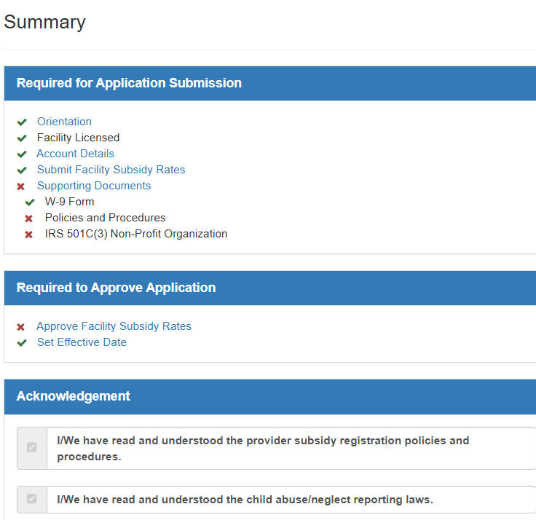
Provider Noncompliance
Noncompliance is failure to act according to the policies and procedures.
Provider Participation Requirements and Certifications/Provider Registration Guide details the subsidy guidelines for providers.
  Generated when completing the Acknowledgements on the summary page in the subsidy application.

Slide 25
Disqualification from the Program
Program participation is terminated when a provider or their employee (not an all-inclusive list)
Has a client’s Arise CARE Attendance App Login
Misuses the QR Code
Substantiated instances of fraud
Failure to make payment on a recoupment plan

Slide 26
Consequences for Noncompliance
Repayment of funds received during a specific time.
Criminal prosecution for an act deemed to be fraudulent
Discontinuation from participation in the subsidy program for a minimum of 30 days or longer

Slide 27
Consequences of Program Violations
Lost of revenue
Lower enrollments
Staff turnover
Subsidy enrollments not replenished due to waiting list

Slide 28
Important to Remember…
CHECK YOUR PORTAL
Enrollment
Weekly Payments
Repayments

Slide 29
Questions
Email questions: childcare.subsidy@dhr.alabama.gov

Slide 30
FAQ’s
How many alternative app users can a parent have? 2 additional app holders
How can a parent add additional app holders? The parent can send an amend application to their CMA eligibility specialist requesting to add the additional app users. The parent will need to add the alternate app user’s email address and phone number.
Who do parents contact when their alternative app users have problems getting their device activated? The parent can contact their CMA eligibility specialist thru the family portal or contact the Arise Help Desk at 888-344-0934.
Does CMA/ HeadStart/ First Class Pre-K follow same minimum DHR standards? Contact your licensing consultant
When does payment start for a new enrolled child on the subsidy program? Payments are made 3 week in arrears and weekly there after.
What are providers supposed to do when the parents do not pay their parental copay? It is the sole responsibility of provider to collect the CMA assessed parental copayment. Failure to collect the copay is considered noncompliance and may result in disqualification from participation in the program. The CMA nor DHR will intervene to assist in collecting the debt.

Slide 31
FAQ’S CONTINUED
When a parent register a child in Arise CARE, is it a freeze on the children enrollment? All new applicants are subject to the wait list until further notice
Can a provider get paid for child's attendance with the submission of sign in/out sheets if a parent cannot register their devise? No, you will not receive payment with the submission of sign in/out sheets. The parents are allowed up to 5 days to report device registration issues to their CMA eligibility specialist for assistance.
What if the information renewal paperwork is still the same, will providers still have to reapply for a new application? Yes, provider registration for subsidy is an annual occurrence.

